Slide 1

The Role of American NGOs Regarding the Objectives of the Secretary of Education of the Republic of Honduras

Slide 2
Education Plan for 2010-2014
1. To improve the access for boys and girls, youth and adults to educational services
3. To improve the quality of education
5. To improve the education process at the local, departmental, district and school level.
access
efficiency
CALIDAD
competition
process
participation
2. To improve the efficiency of the Educational System
4. To form human resources for labor and professional investment that will guarantee success
6. Promote parental participation, as well as single mothers and educational community
Development of Educational Center.

Slide 3
Major Accomplishments of the Secretary of Education.
Implementation of the Master Plan for School Infrastructure.
Transparency Portal availability www.se.gob.hn
Fairs and events.
Implementation of Public Hearings.

Slide 4
Major Actions of the Secretary of Education
Supervision and support to students.
Production of texts with national editorials.
Relaunching of the Bilingual Intercultural Education Program.
Processing of payments to teachers trough the educational trust fund.

Slide 5
Working with NGO´S
Working to meet the goal of 200 school days, required by Law.
Execution of Educational Projects in hospital rooms at the Materno Infantil Hospital, Mario Catarino Rivas Hospital and the San Felipe Hospital.

Slide 6
Working with NGO´S
Execution of the Program for the implementation of mobile laboratories TIC´s, through the donation of 70 computers.
Educational program “One computer per child”, directed to very low income elementary students from public educational centers located in urban and rural areas of the country.

Slide 7
Working with NGO´S
Supporting PROHECO this program will financially assist the mother’s association for the construction of school buildings and project management training.
Training of elementary and middle school students that teaches them about free enterprise, business and the economy as a way to improve life conditions.

Slide 8
COMPETITIVENESS
Routinely apply the use of technology information and communication (TICs).
Routinely apply the english learning program, starting from the 4th grade, and have english as a second language.
.
Secretaría de Educación

Slide 9

QUALITY
Goals:
100% of educational centers (grades school and middle schools) applying the National Curriculum Design, adapting it to local needs and responding to national standards.
10% of educational centers are recognized as quality centers.
Secretaría de Educación

Slide 10
Providing educational materials for grade, middle and High School in Honduras.
At the level of basic education, 38% of the schools have one teacher and 24% have only two teachers.
It is of the uptmost importance to give support to these centers in order to improve the process of learning.
Secretaría de Educación

Slide 11
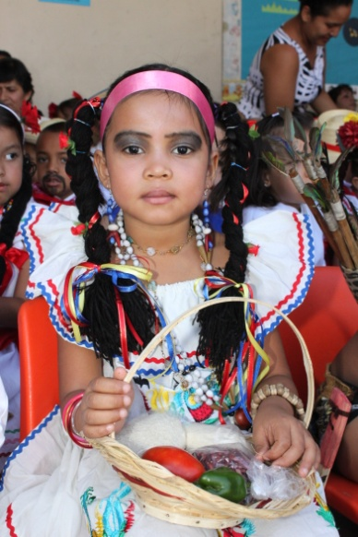
Program to Teach English as a Second Language.
Create opportunities to learn English through different technologies: texts, recordings, hearing aids, videos and computers.
Secretaría de Educación

Slide 12
Provision of Solar panels.
Support and stimulate the development of the educational community in those centers that lack technological resources, through the implementation of renewable energies.
Strengthen the Program Lights to Learn which is carried out by OEI
Secretaría de Educación

Slide 13
Establishment of Libraries in Basic Learning.
That permit the strengthening of the learning process.
Secretaría de Educación

Slide 14
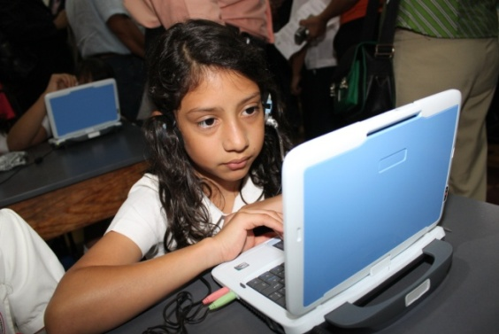
Support to Strengthen the Program One Computer per Child
Diminish the digital gap increasing the coverage and access to internet.
Boys, girls, youth, teachers, parents and single mothers will have the opportunity to incorporate the use of computers to de educational process, as a tool to enrivh the learning process and learning qith new educational resources.
Secretaría de Educación

Slide 15
Infrastructure
Support fo the execution of reconstruction of Schools, with the goal of improving the classroom experience and also the process of teaching and learning.
Secretaría de Educación

Slide 16
Carryout a Program of sponsorship of schools
That contributes to resolve the problems of the classroom situation, related to the lack of classroom furniture, educational materials, technologigcal materials, etc., by granting these resources.
Scolarchips for students with academic excellence.
Secretaría de Educación

Slide 17
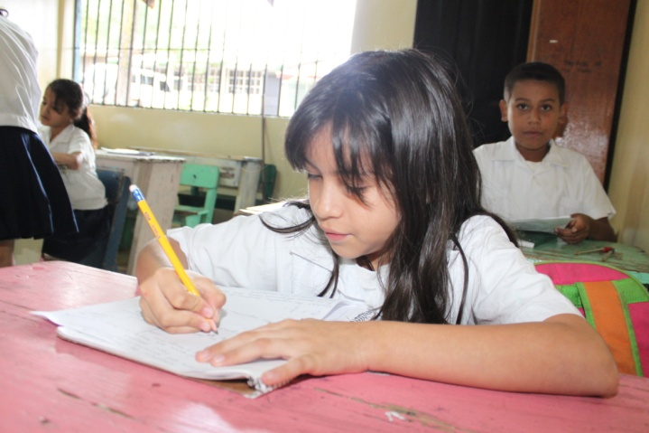
Execution of water and sanitation programs in those schools in the rural areas of the country.
Donation of water purifiers in the schools in the rural areas of Honduras.
Secretaría de Educación

Slide 18
Contacts
guijelo@yahoo.es
Lic. Jeremías
lourdesghe@yahoo.com
Lic. Lourdes Hernández

Slide 19

THANK YOU!
Secretaría de Educación

